Slide 1

A Socially Relevant Project –II Presentation on COLLEGE EVENT MANAGEMENT
Presented by the Batch
Name:K.Vamsi Roll No:19121A1558
Name:J.Santosh Roll No:19121A1543
Name:A.Pavan Kumar Roll No:19121A1502
Name:K.Shashank Roll No:19121A1545
Name:G.Sreenivas Roll No:19121A1538
Computer Science and Systems Engineering
Under the guidance of:
Shaik Salam
Associate Professor
Dept. of CSSE
HOD:
Dr.K.Ramani
Professor
Incharge HOD,Dept. of CSSE
Sree Vidyanikethan Engineering College

Slide 2
Contents
Abstract
Objectives
Analysis
Design
Implementation / Proposed approach
Results
Applications
Limitations
Conclusion and Future Work

Slide 3
Abstract
College Event management system is a convenient approach to register and view events within the campus according to the user’s interest and desired time. Earlier if any user need to know about the events that are being held in the department they need to go to organizers which is a tedious job. So, we solve this task by designing a web-based application. This web application provides the users with a user friendly GUI and helps in knowing information regarding the events (technical & non-technical) happening on weekly basis, for participation, and for winner’s details which are updating on daily basis. When users click on the respective event which helps in displaying the details of that event along with registration option. Once users click on the registration option a registration form will populate where the users need to fill the required details for registration. On any queries related to events or any issues during registration process this application having an option of contact us which will display the list of the coordinators who can help on solving the issues.

Slide 4
Objectives
To reduce the time consumption of explaining about the events in person to person.
To improve the number of participants list.
To improve all the events, without any interruptions in time, date and venue of the event.
To achieve fast and accurate delivery of the information.
Web application will helps in ease accessibility to know the events happening in department and registration for events without any third person involvement.
To give the privilege of accessing web application at anytime from anywhere by any user.

Slide 5
Analysis
MODULES
Home Page Home page consists of event details such as event name, description of the event, category and starting date of the event, sign-in button.
Header Header consists of search bar, login button and event management hyper link which reflects on the same page.
Footer Footer describes about the event management details such as email, contact number and location

Slide 6
Login The login page consists of two fields they are email and password, which allows the user to login to existing account. If user doesn’t have an account, there is sign up option to create a new account.
Sign-up The sign-up form consists of four fields, they are name, email, password and confirm password which allows the user to create a new account. If the user has an account, there is login option to login to the account
Admin Home When the admin login into his account it reflects admin home page. It consists of event details and it also has event hyper link which helps the admin to make changes in the web page, sign out option to get back into website name page

Slide 7
Admin view This page consists of event details such as name, category, start date, end date, coordinator name and action buttons that allows the admin to edit an event and to delete an event. It also consists of add new button to add a new event.
Add New Event The add new event consists of fields such as name, description, category, coordinator name, start date and end date which allows the admin to add events
User Home Home consists of event management hyper link that reflects the home page, a search bar to search the events and join event button to join/register event and sign out option to exit from his/her account.

Slide 8
Join Event
It consists of event details and a join event button to fill the registration form and join the event
Event Registration Form The Event registration form allows the user to register for an event by giving details of user such as name, roll no, email id, mobile number and a submit button to submit the form.
Email Confirmation After submitting the details in the event registration form the user and coordinator receives a confirmation mail with name and roll no of the student/user.

Slide 9
SYSTEM REQUIREMENTS
RAM-4Gb (minimum)
Internet connection required
Operating system- windows 10 and above
Front end- HTML, CSS, Boot Strap
Middle ware:php
Back end:MySQL

Slide 10
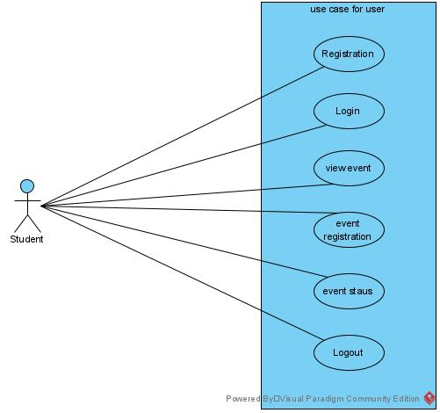
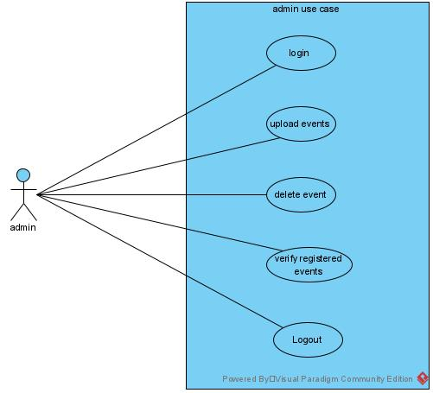
System Design
Figure Use Case Diagram for User and Admin

Slide 11
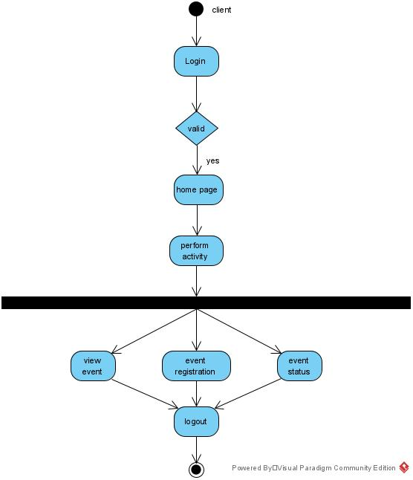
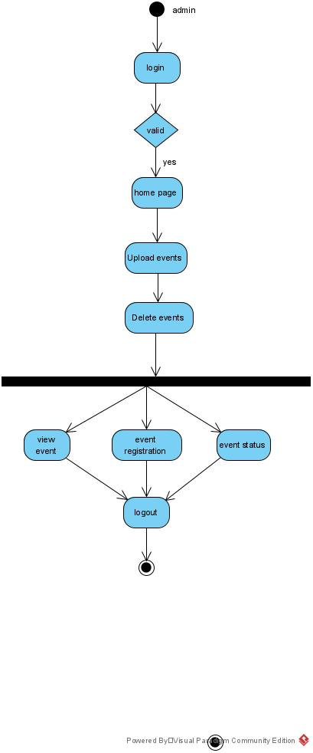
Activity diagrams are graphical representations of workflows of stepwise activities and actions with support for choice, iteration and concurrency.
Figure activity diagram for user and admin

Slide 12
Proposed Approach
This web based system is implemented in colleges for booking of events in a easier way. The user gets all the information at a single place instead of wondering round for others. This system provides the user all the information regarding the events such as name of event, time, venue, start and end date of the event and it also provides email confirmation for the user when he register for a event. This system is effective and saves the time of the user and coordinator.

Slide 13
Implementation
The college event management systems allows the admin to login into the systems and allows the user to login into the systems and allows to register into the system if he is a new user. The user and admin should enter the system by entering registered email address and password on the login page.
Once entering a page an admin can perform the functions such as adding an event by giving the event details or delete an event when the event is cancelled or finished or try to update the event in necessity conditions. The user can view the details of the event such as name of event, venue and time in the description field and starting and ending date of the event and also can join the event by filling the registration form of the event which confirms to the user by sending the confirmation mail from the system.

Slide 14
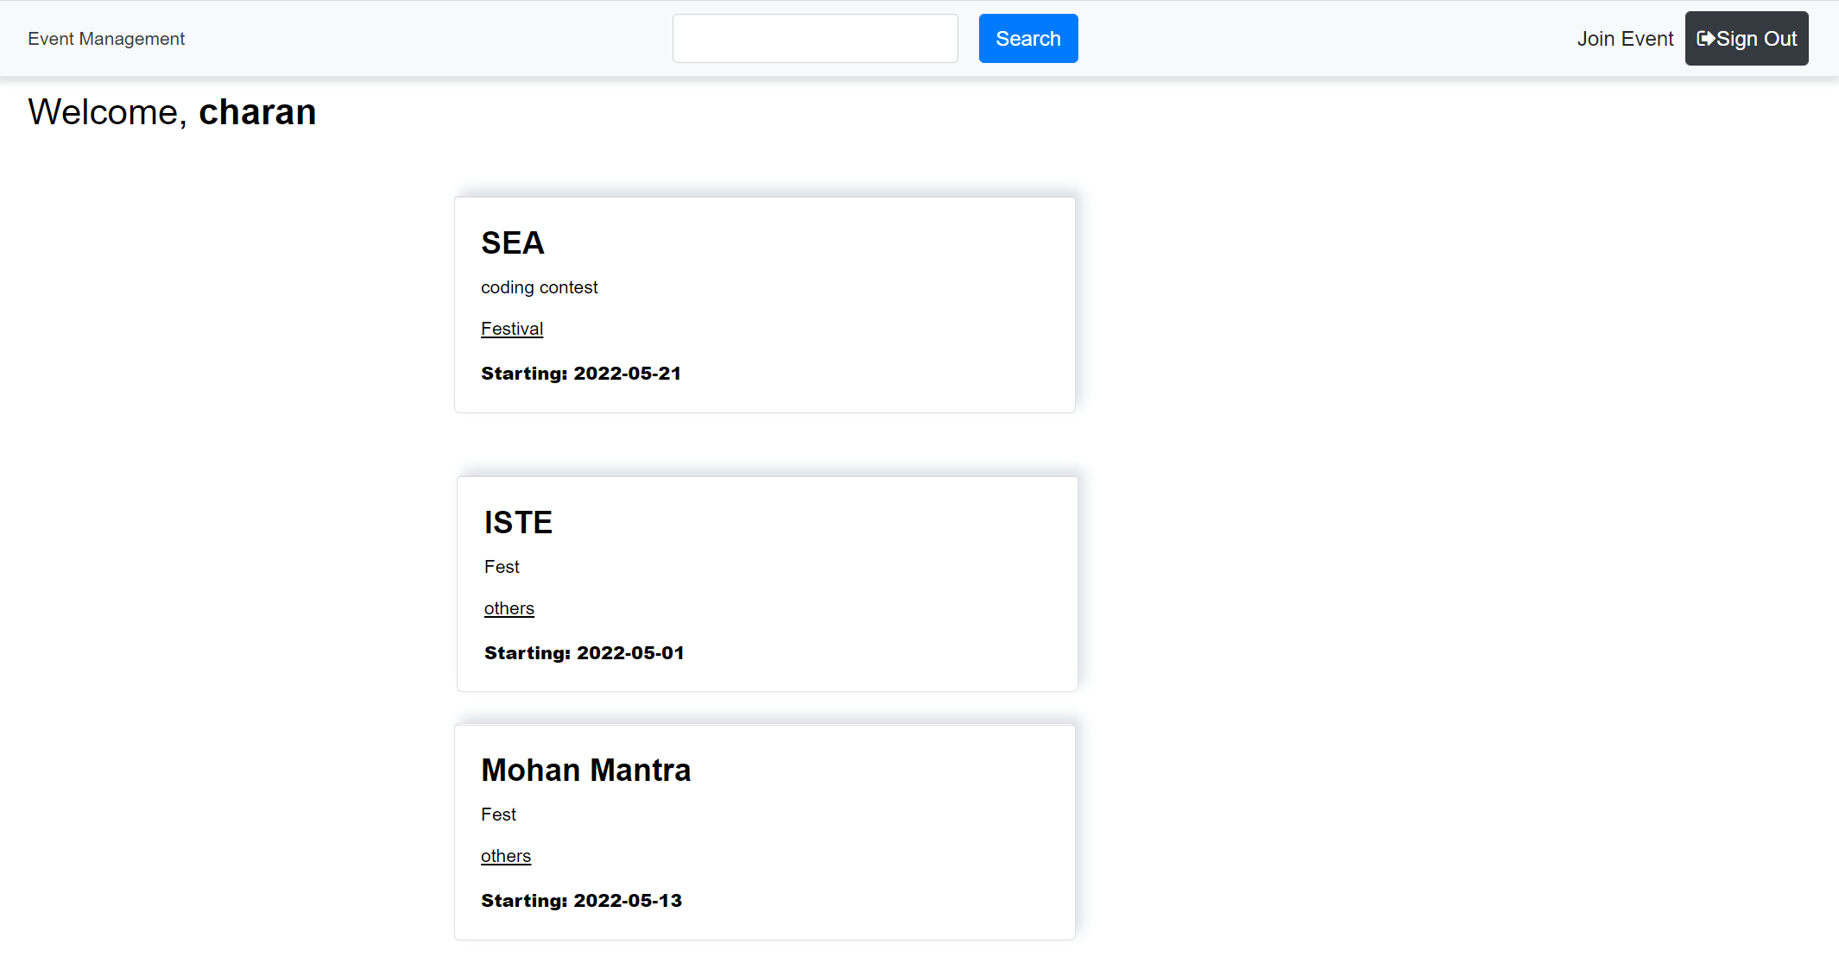
Results
Home Page

Slide 15
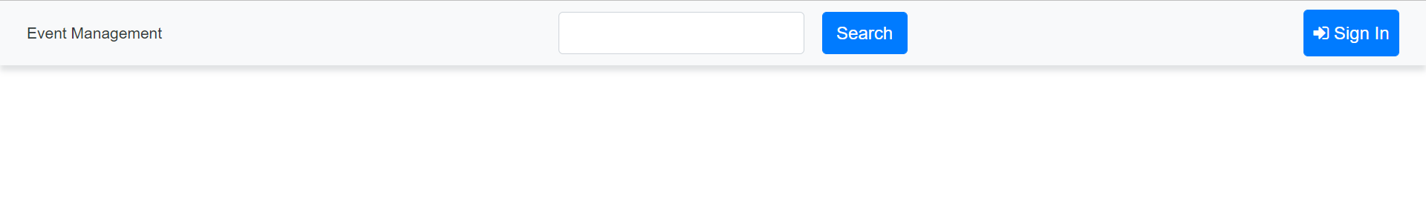
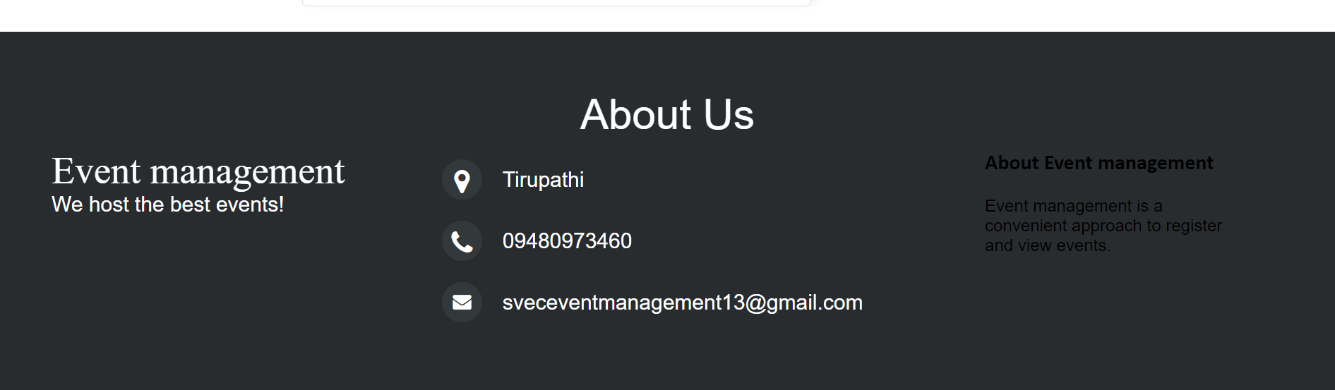
Header
Footer

Slide 16
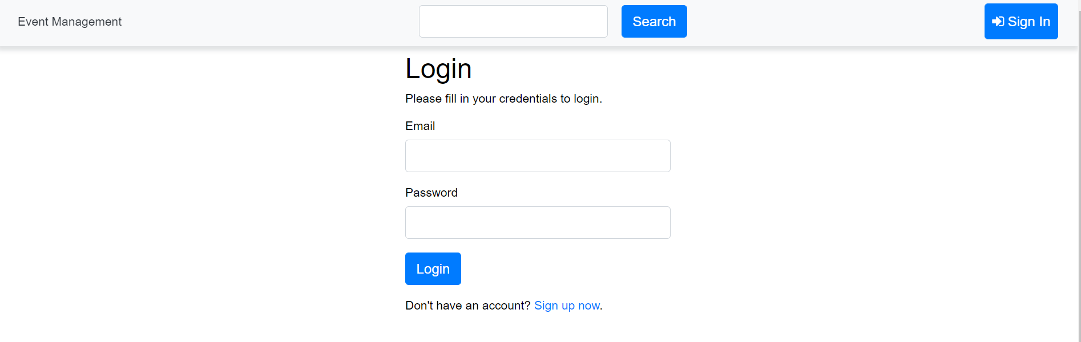
Login

Slide 17
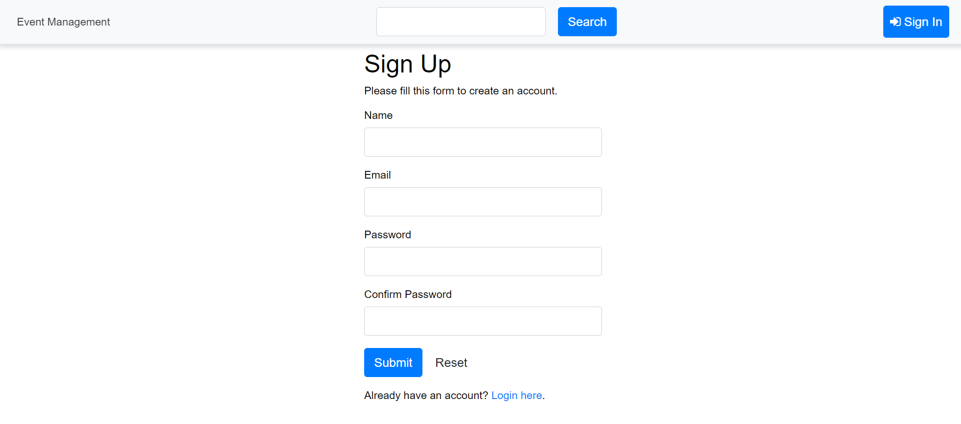
Sign up

Slide 18
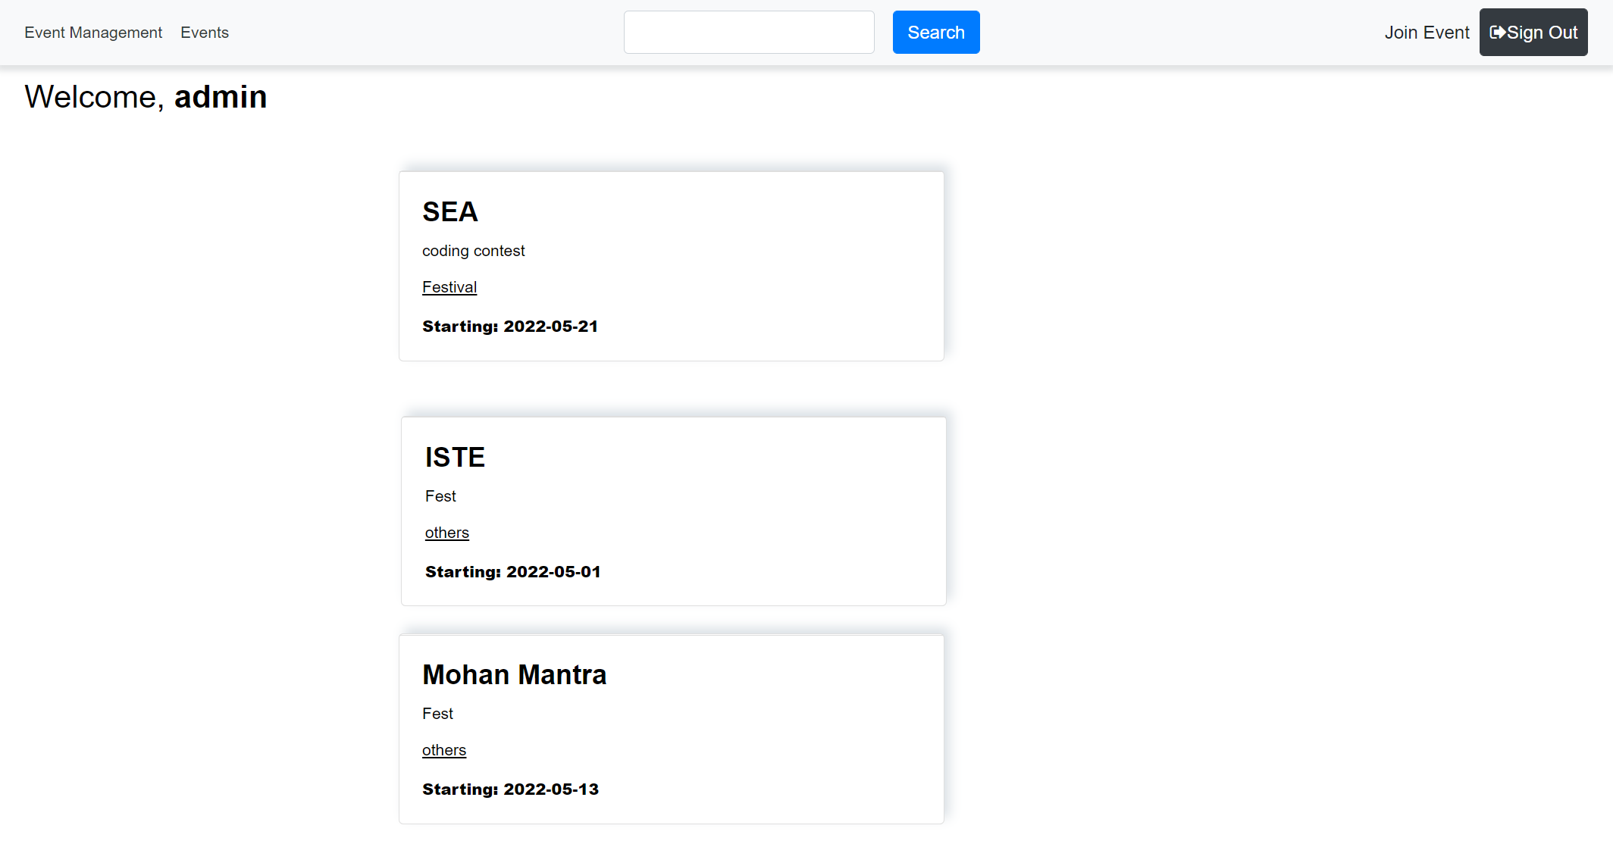
Admin Home

Slide 19
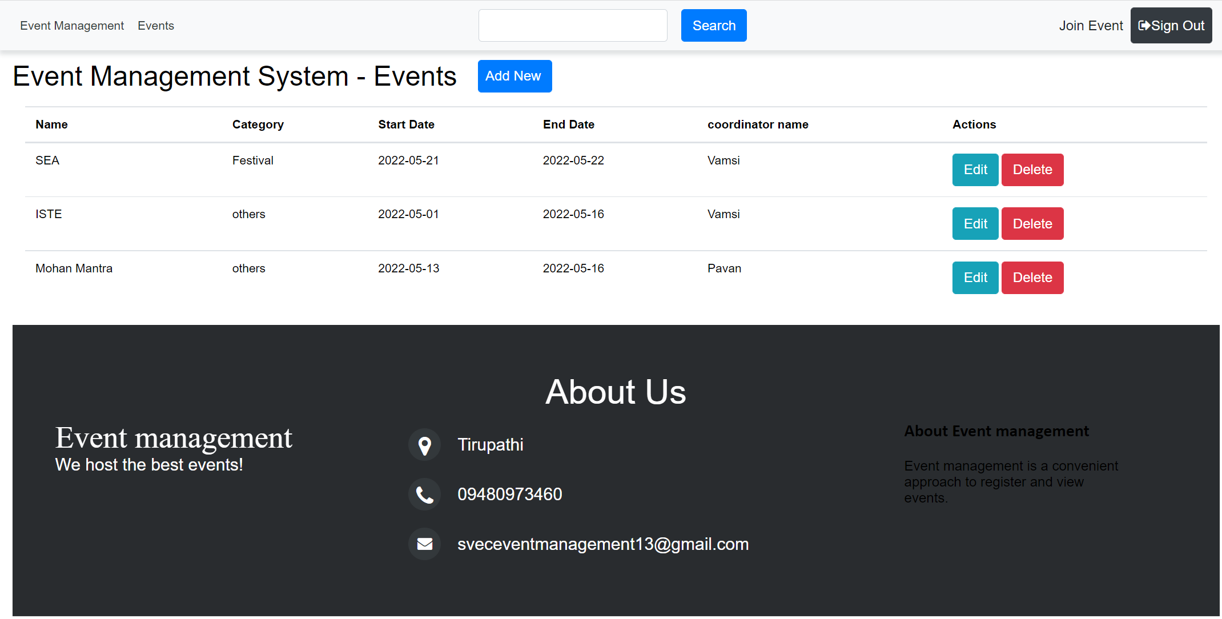
Admin View

Slide 20
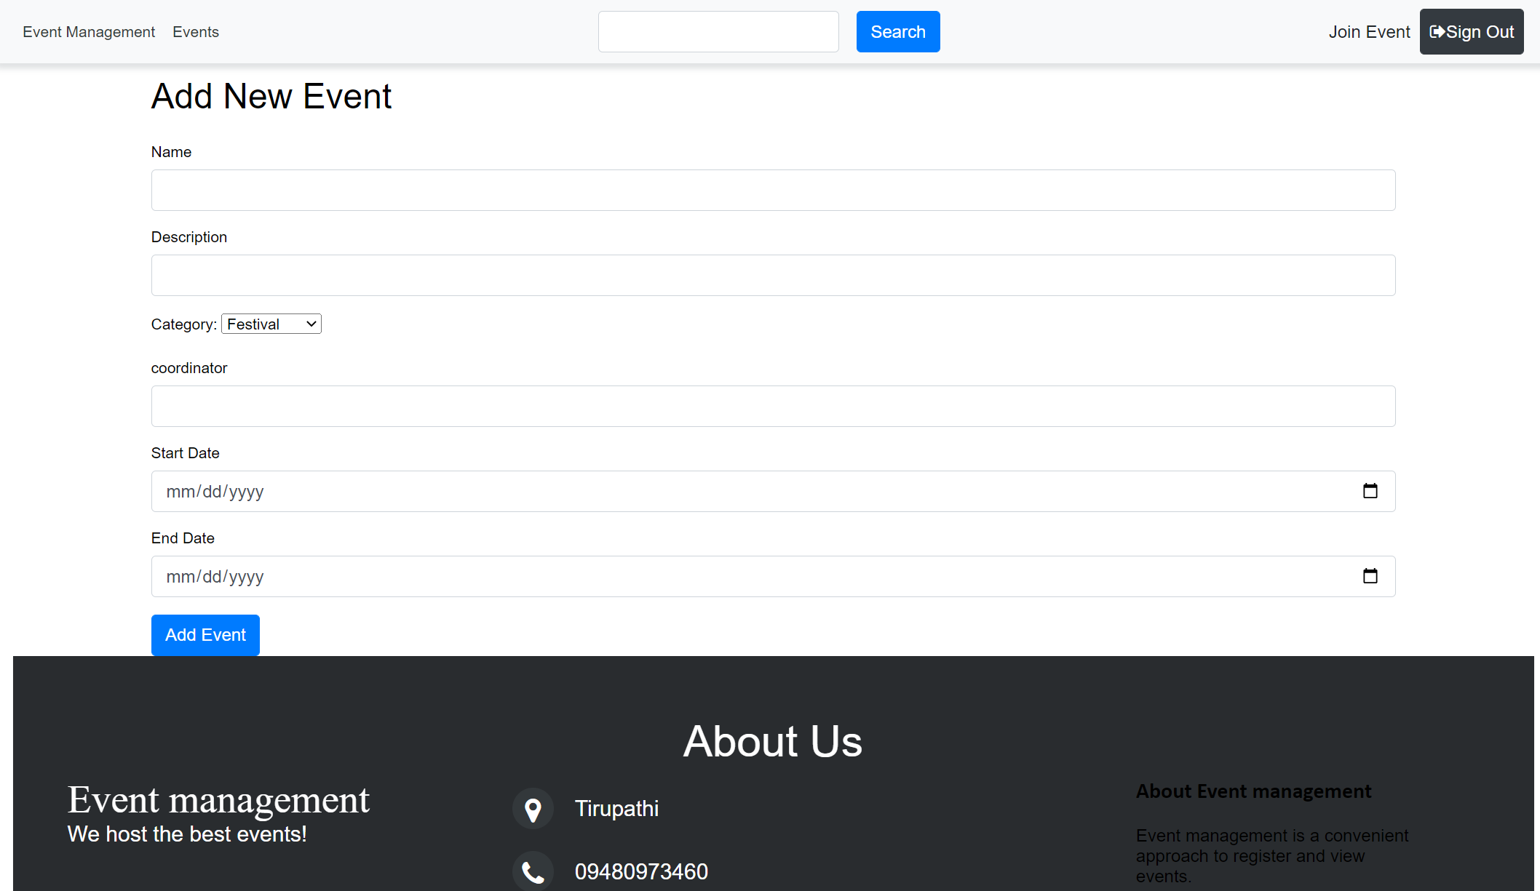
Add New Event

Slide 21
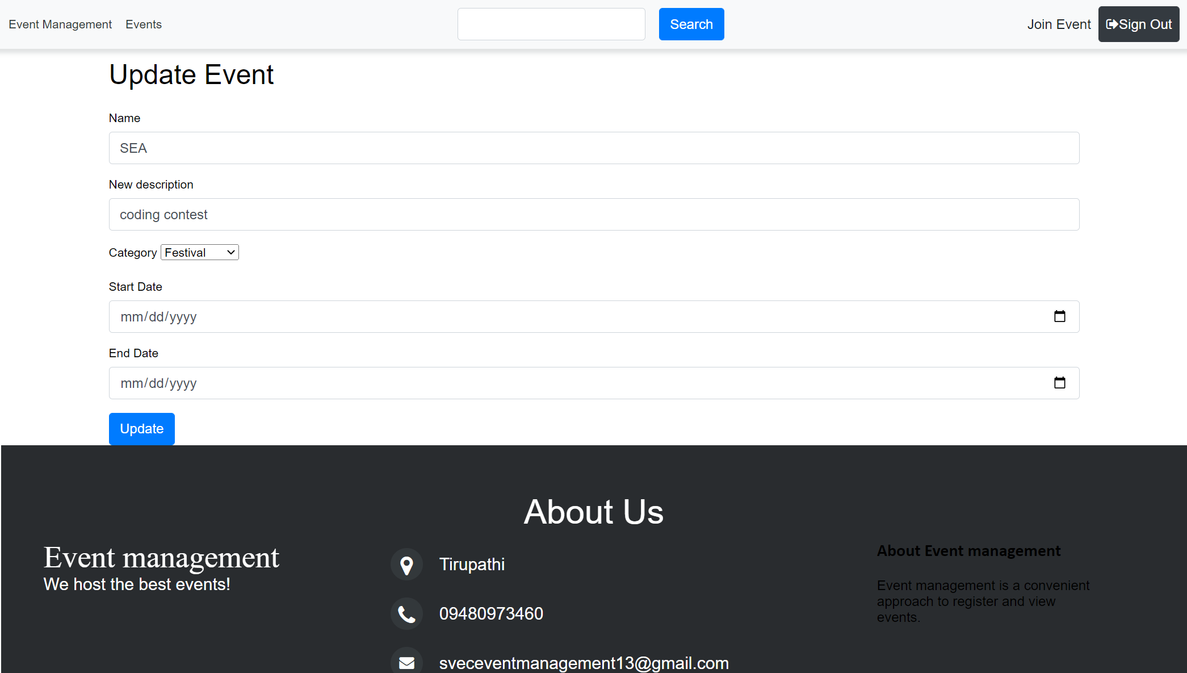
Edit Event

Slide 22
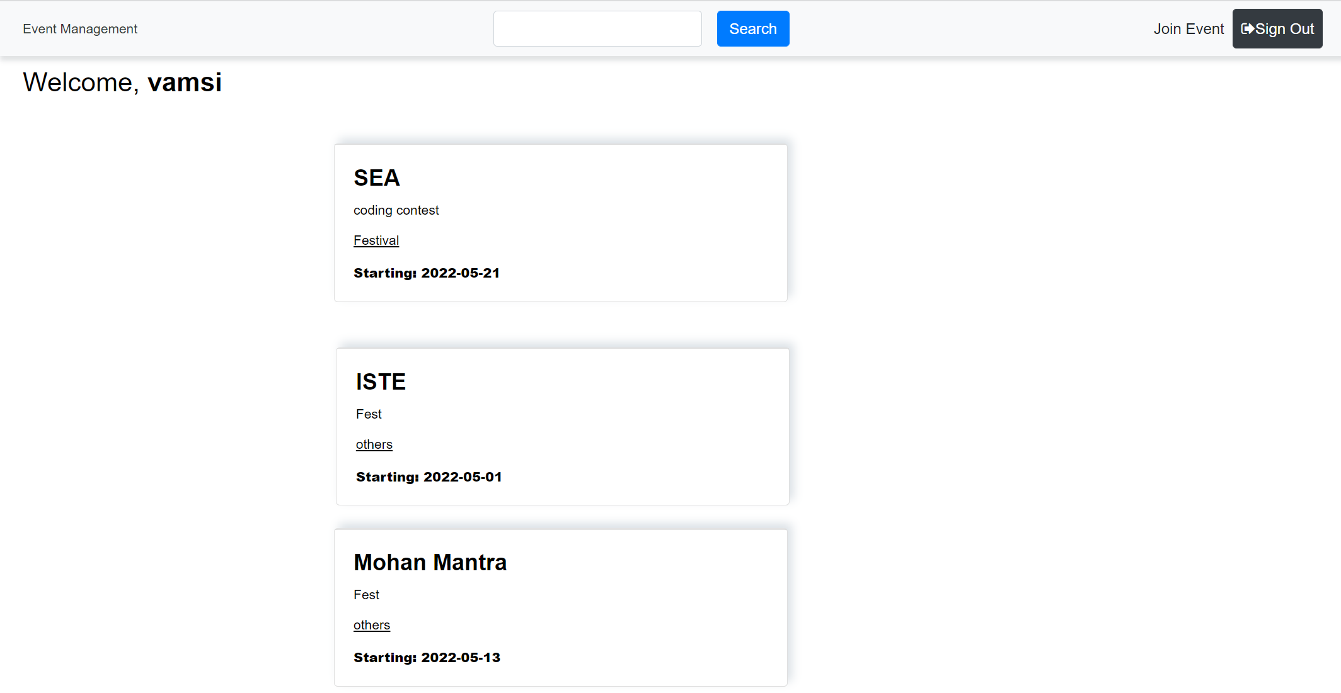
User Home

Slide 23
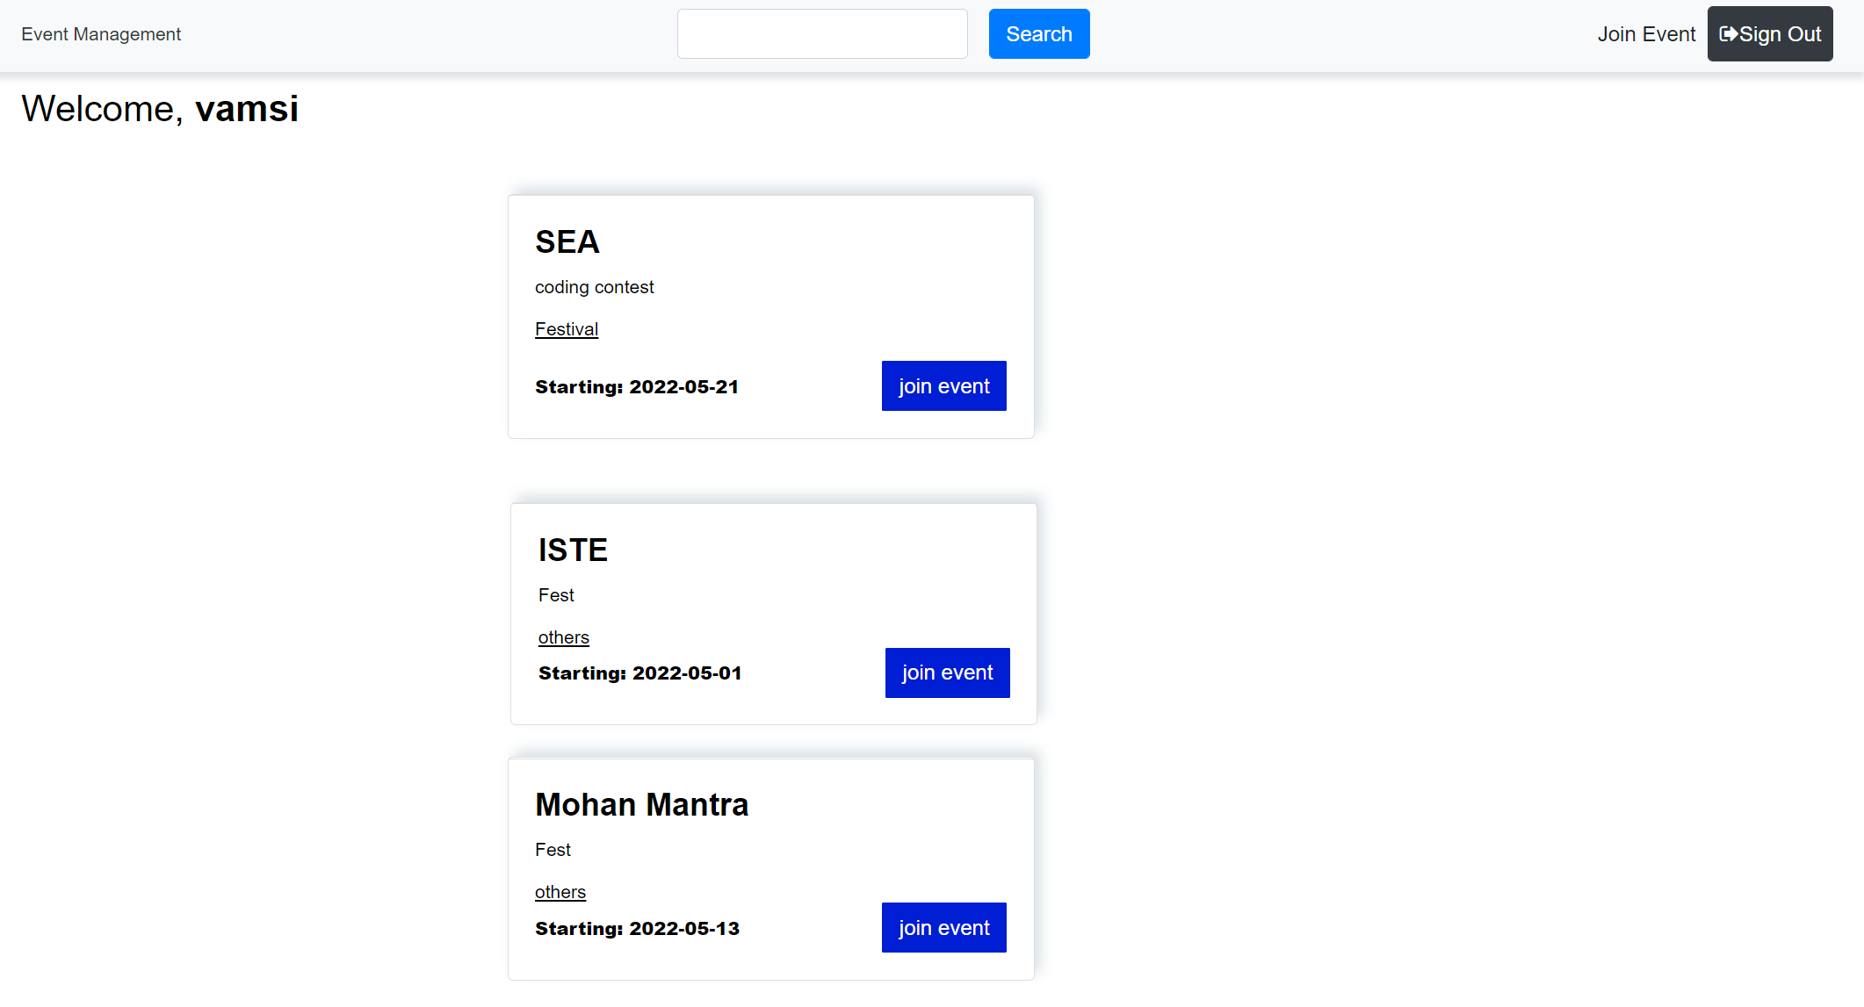
Join Event

Slide 24
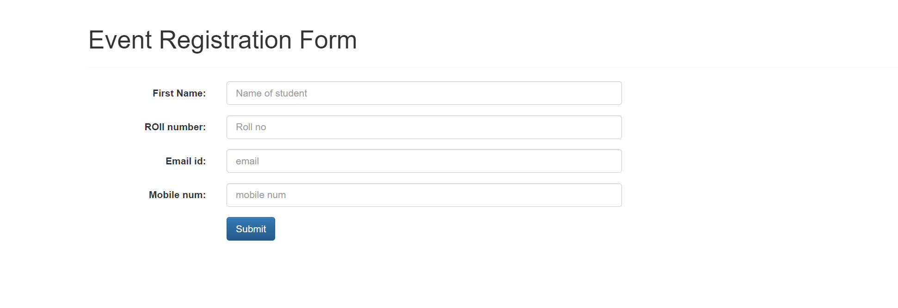
Event Registration Form

Slide 25
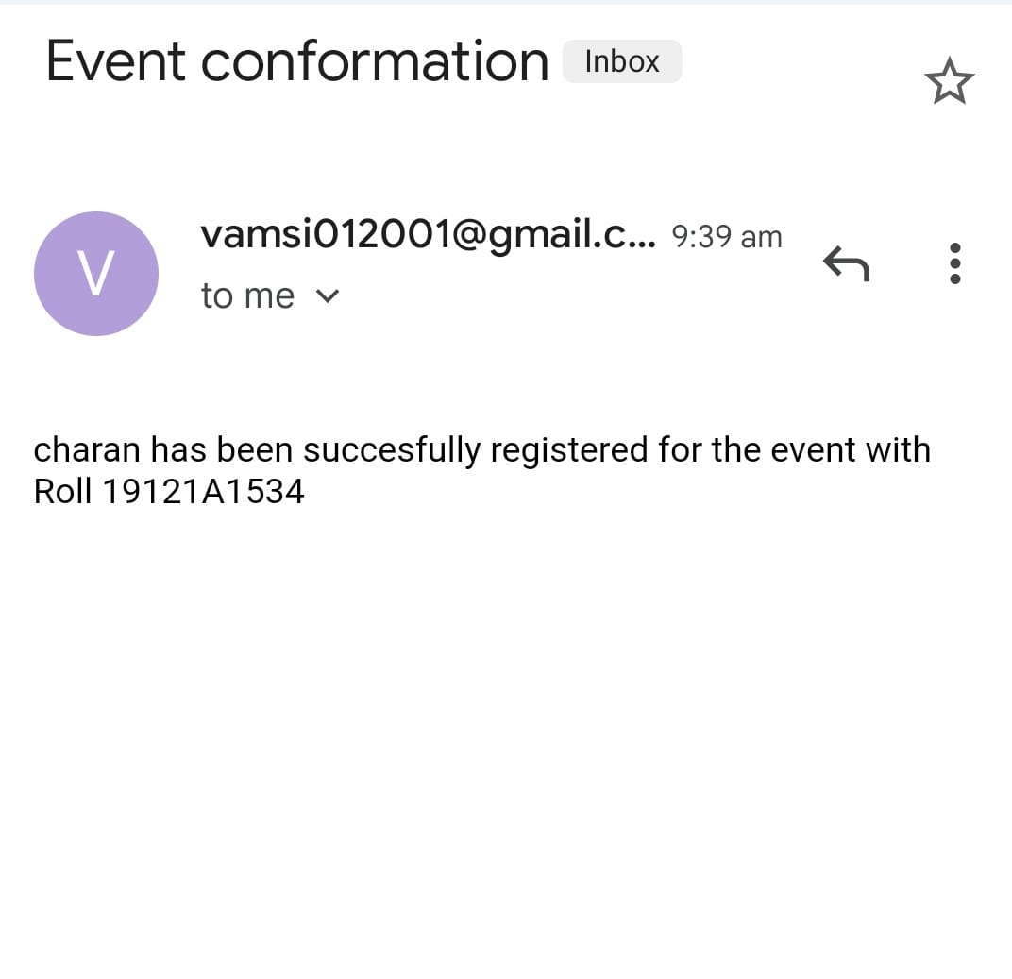
Email Confirmation

Slide 26
Applications
It reduces time consumption in the organization.
It avoids miss communication and miss understanding regarding the events in the organization.
It reaches entire organization in one shot.
It reduces the culture of notices and pamphlets.

Slide 27
Limitations
This approach can send only email notifications
We need to improve this approach where the user can get the text message for their respective mobiles
Generally some people don’t check their mails regularly and there is a chance that they may miss some events
This prototype only sends the confirmation that the user got registered for the event but not which event he registered for

Slide 28
Conclusion
Event management app provides an detailed information about the event details and venue details. It shows the event details in the home page when the event is triggered by the admin. So therefore all stakeholders of the app can view and register for the event. With this type of approach the count of the participants can be increased. It saves a lot of time for the organizers and provides them an easy way to handle their works.

Slide 29
Thank You

